Slide 1



DermaScope AI An AI-Driven Ecosystem for Autonomous Skin Disease Diagnosis and Proactive Management
24-25J-210

Slide 2




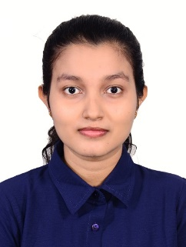


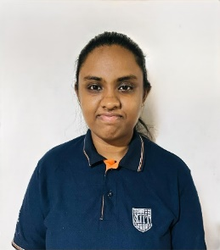
Mr. Samadhi Rathnayake
Supervisor
Gimmana M.R.M IT21176456
Dr. Junius Anjana
Co - Supervisor
Lakshani D.M.W.S
IT21262104
Dr. Saman Gunasekara
External Supervisor
Dr. kasun Nayanakantha
External Supervisor
Perera W.A.S.K
IT21261732
Project ID: 24-25J-210

Slide 3

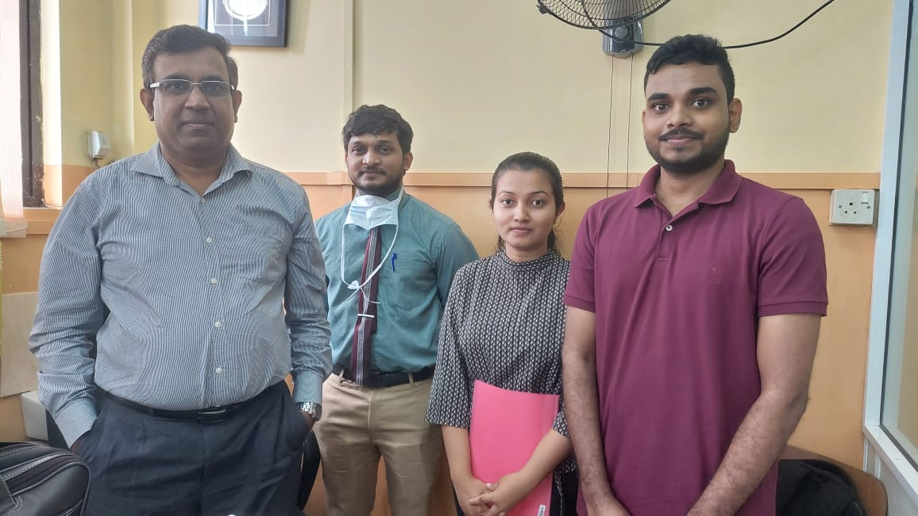
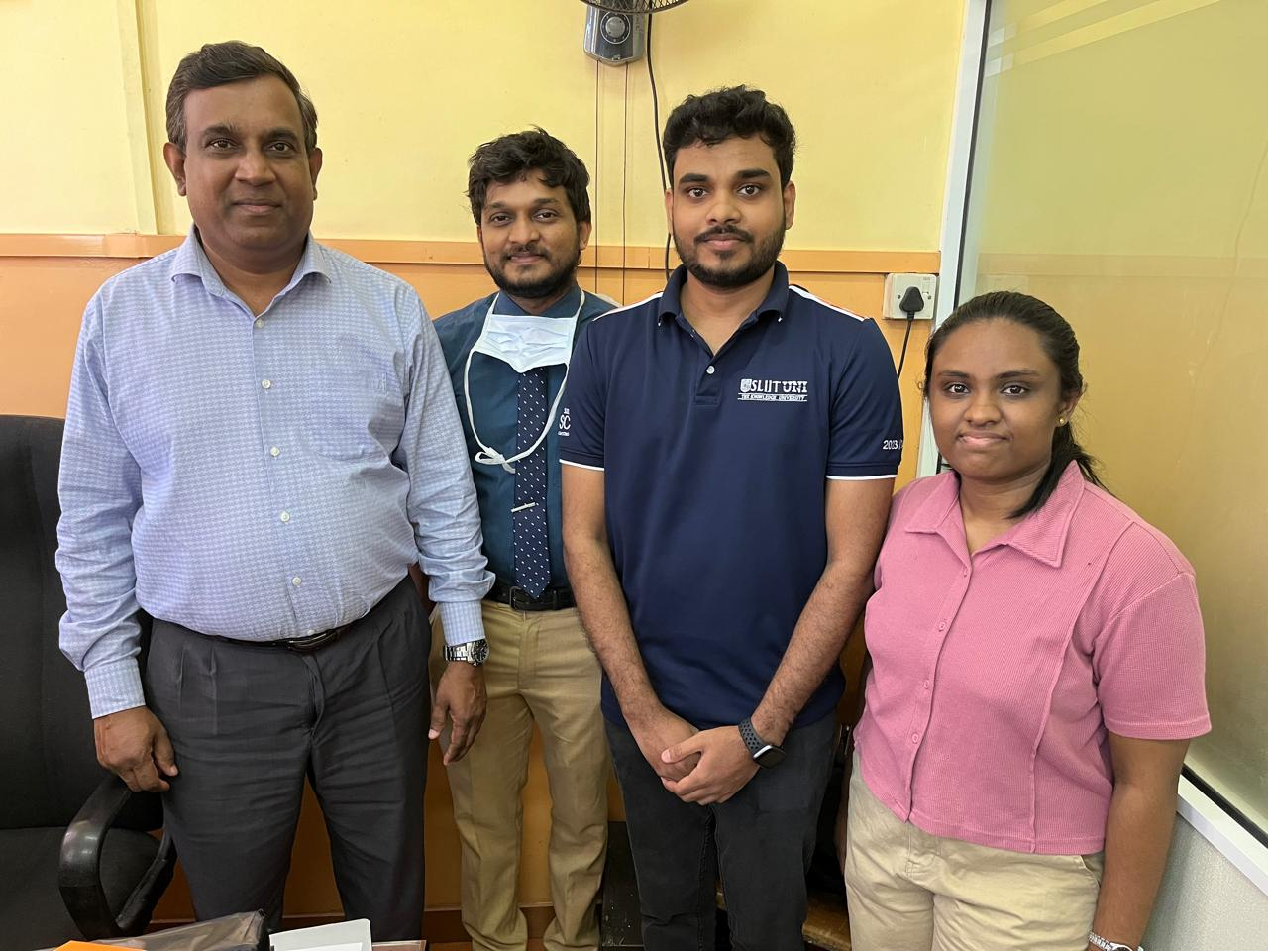
Dr. Saman Gunasekara
External Supervisor
MBBS. MD. (Dermatology)
Consultant Dermatologist
Teaching Hospital - Kalubowila
Dr. kasun Nayanakantha
External Supervisor
Dermatologist
Project ID: 24-25J-210

Slide 4
Introduction
Skin Diseases
Skin diseases are conditions that affect your skin.
They may cause rashes, inflammation, itchiness or other skin changes.
Some skin conditions may be genetic, while lifestyle factors may cause others.
Project ID: 24-25J-210

Slide 5
Research Question
How to leverage machine and deep learning for enhanced dermatological care?
Up to what extent machine and deep learning can be used in Dermatology?
How trustworthy and useful are the built models?
How transparent is this technology?
Project ID: 24-25J-210

Slide 6

Answer!
Introduce optimized methods and algorithms to efficiently analyze
skin diseases while align with dermatological theories and laws.
Trustworthiness and transparency of the technology used.
Project ID: 24-25J-210

Slide 7
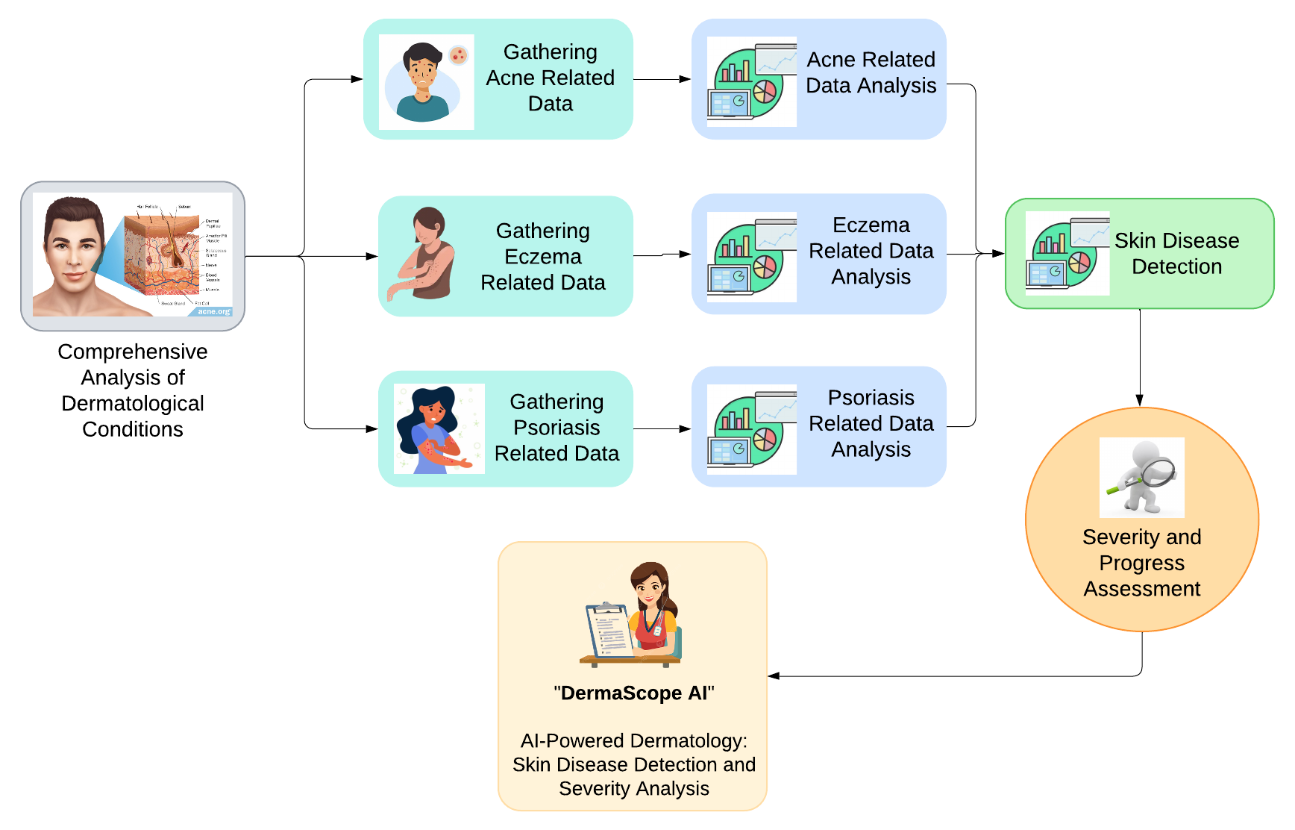
System Diagram

Slide 8

5
Research Objectives
4
Develop a System for Real-Time Monitoring and Management of Skin Diseases Using AI and Machine Learning Techniques.
3
2
1
Project ID: 24-25J-210

Slide 9

5
Research Objectives
4
Enhance Diagnostic Accuracy and Efficiency in Skin Disease Detection and Management Through Advanced Machine Learning Techniques.
3
2
1
Project ID: 24-25J-210

Slide 10
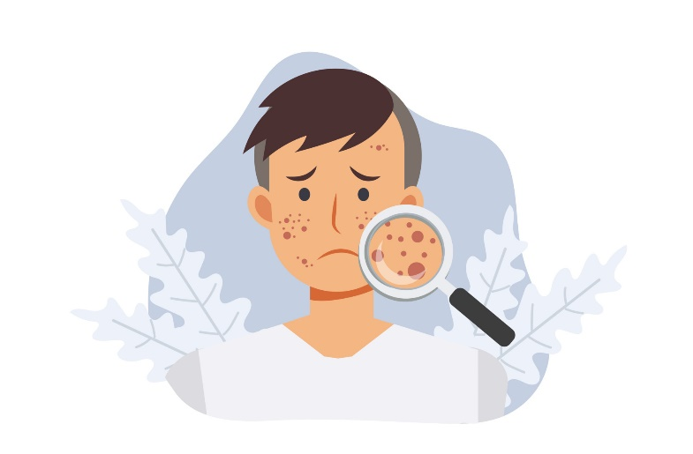
5
Research Objectives
4
Develop a Comprehensive Suite of Machine Learning and AI-Based Models for Acne Assessment and Management.
3
2
1
Project ID: 24-25J-210

Slide 11

Research Objectives
5
4
Develop an Advanced System for Accurate Detection and Severity Assessment of Eczema Using Image Processing Techniques.
3
2
1
Project ID: 24-25J-210

Slide 12
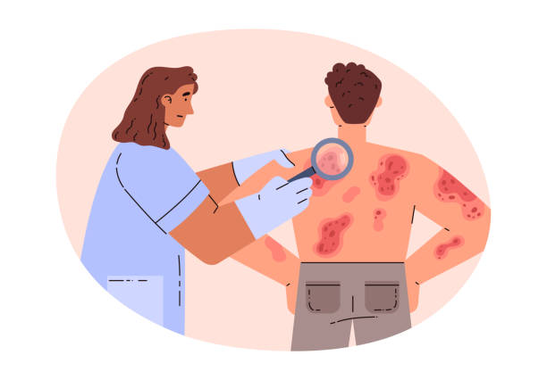
Research Objectives
5
Apply Machine Learning and Computer Vision to Detect Psoriasis and Assess Its Scaling Severity from Images.
4
3
2
1
Project ID: 24-25J-210

Slide 13
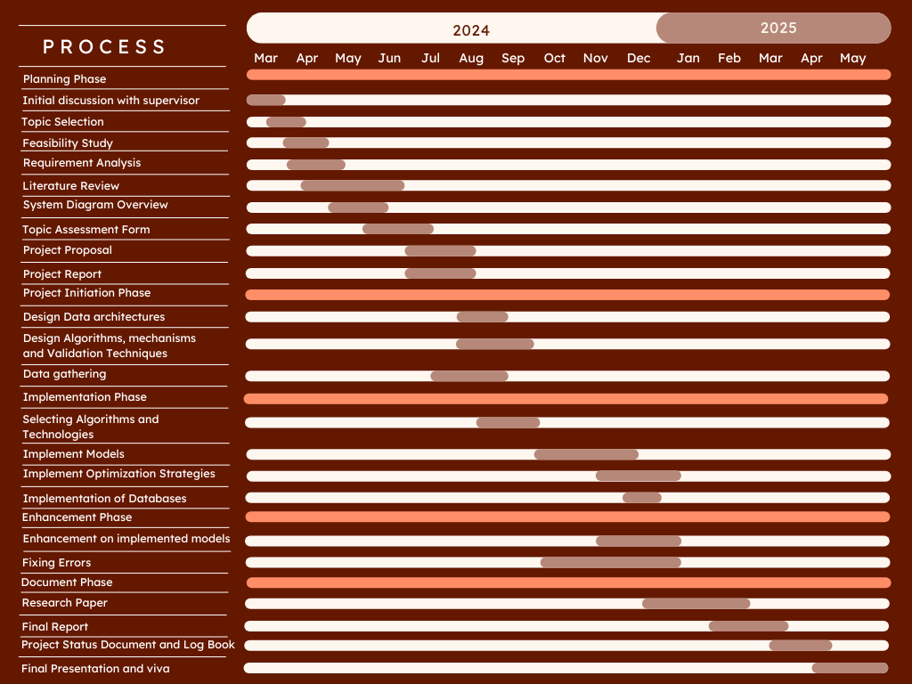
Gannt Chart
Project ID: 24-25J-210

Slide 14

Component 1
Automated Advanced Acne Lesion
Analysis and Monitoring with Artificial Intelligence.
IT21176456 | Gimmana M.R.M
B.Sc (Hons) Degree in Information Technology Specializing in Data Science
IT21176456 | Gimmana M.R.M | 24-25J-210

Slide 15

What is Acne ?
Acne is a common chronic disorder affecting the hair follicle and
sebaceous gland, in which there is expansion and blockage
of the follicle and inflammation.
Who gets Acne?
Acne affects males and females of all races and ethnicities.
It is prevalent in adolescents and young adults,
with 85% of 16- to 18-year-olds affected.
However, it may sometimes occur in children and adults of all ages.
IT21176456 | Gimmana M.R.M | 24-25J-210

Slide 16
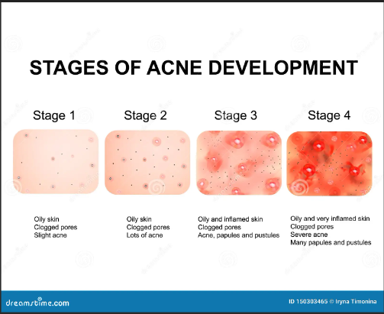
Acne Stages
IT21176456 | Gimmana M.R.M | 24-25J-210

Slide 17
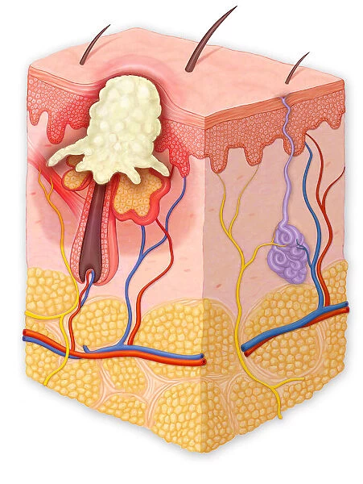
Research problem
How can we develop advanced machine learning techniques be leveraged through image analysis to enhance the precision of acne diagnosis and monitor treatment efficacy?
IT21176456 | Gimmana M.R.M | 24-25J-210

Slide 18
Completed Tasks
Data Validation: Collaborated with external supervisors to validate the dataset, ensuring its quality and relevance.
Model Development: Developed two deep learning models:
1. Acne Detection Model
2. Acne Severity Detection Model
Completed Work ~ 50%
Data Preprocessing: Checked the balance of the dataset and Split the data set into training and testing sets.
Data Augmentation: Applied data augmentation techniques to the training and testing sets to increase data diversity and model robustness.
Model Training and Evaluation: Trained deep learning models, performing hyperparameter tuning to optimize performance. Evaluated model performance using appropriate metrics (e.g., accuracy, precision, recall, F1-score).
Web Application Development: Created web applications to enable users to test the acne detection and severity classification models with their own images.
IT21176456 | Gimmana M.R.M | 24-25J-210

Slide 19
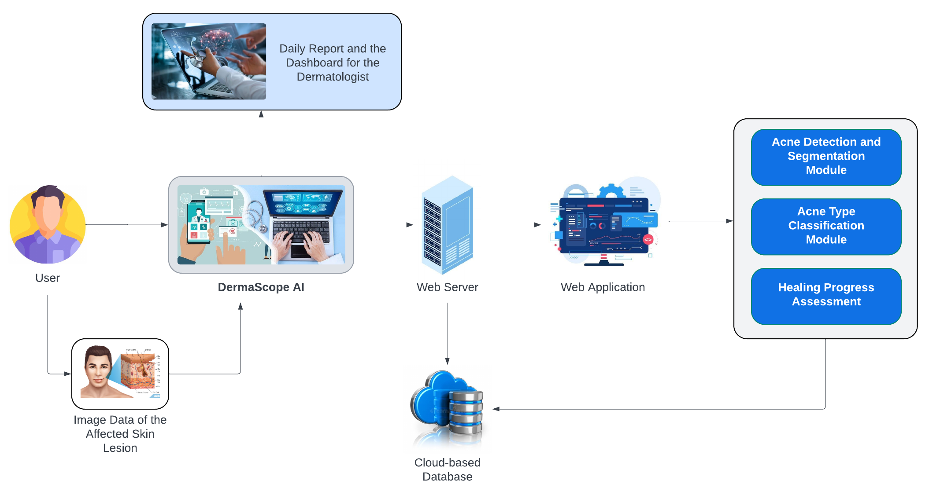
System Diagram
IT21176456 | Gimmana M.R.M | 24-25J-210

Slide 20
Requirements
Personal Requirements
Guidance from the Supervisors on the Acne and Data Science domain.
Understand the Specific Area of Each Domain to Proceed with the Selected Research Area.
Functional Requirements
Acne Detection Module.
Severity Assessment Module.
Dynamic Segmentation Adjustment.
Non-Functional Requirements
Performance.
Scalability.
Usability.
Security and Privacy.
Reliability.
IT21176456 | Gimmana M.R.M | 24-25J-210

Slide 21
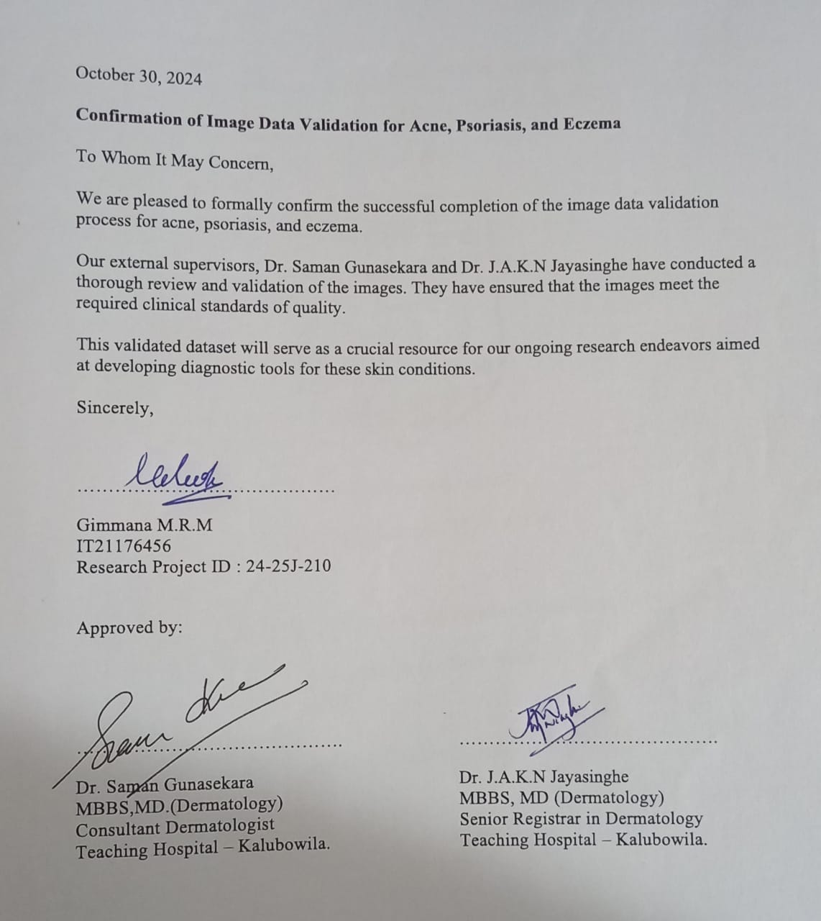


Data Collection & Validation
IT21176456 | Gimmana M.R.M | 24-25J-210

Slide 22
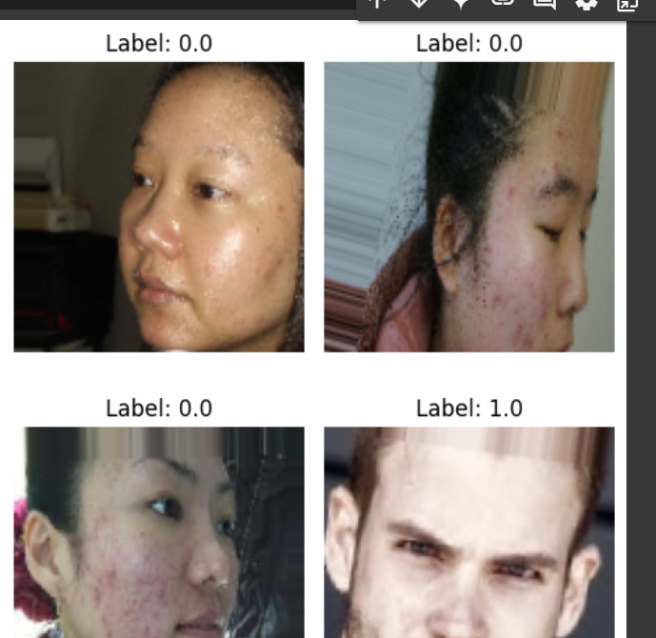
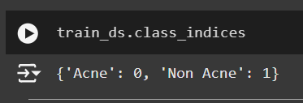
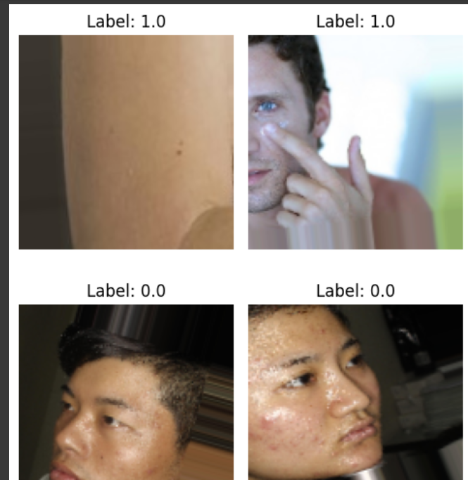
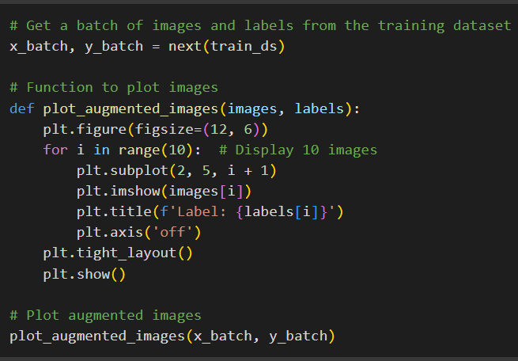
Data Exploration
Acne Dataset
IT21176456 | Gimmana M.R.M | 24-25J-210

Slide 23
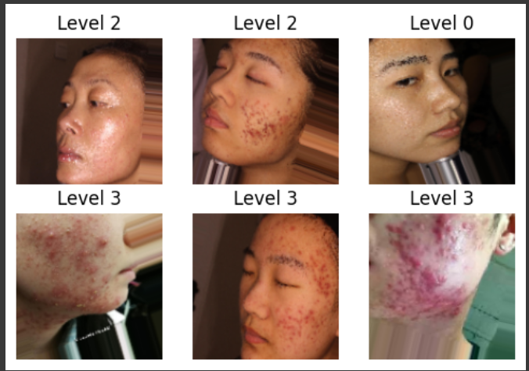
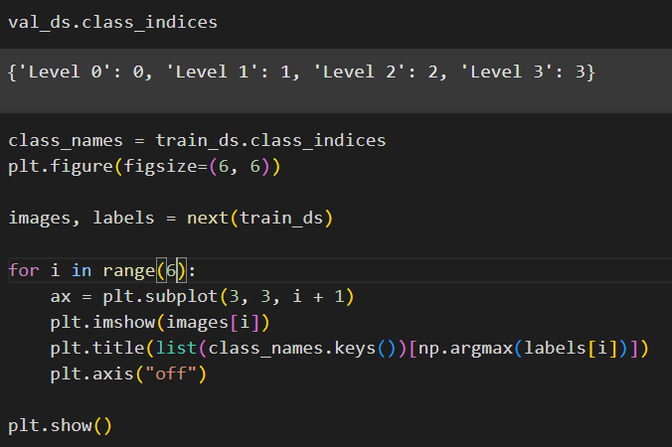
Data Exploration
Acne Severity Dataset
IT21176456 | Gimmana M.R.M | 24-25J-210

Slide 24
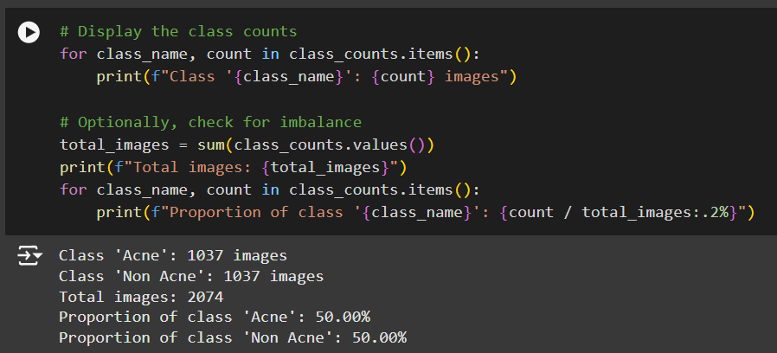
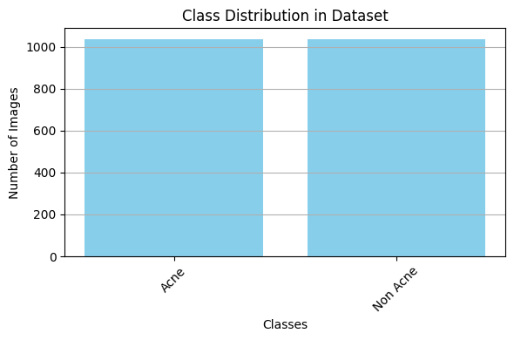
Exploratory Data Analysis
Acne / Non-Acne Dataset
IT21176456 | Gimmana M.R.M | 24-25J-210

Slide 25
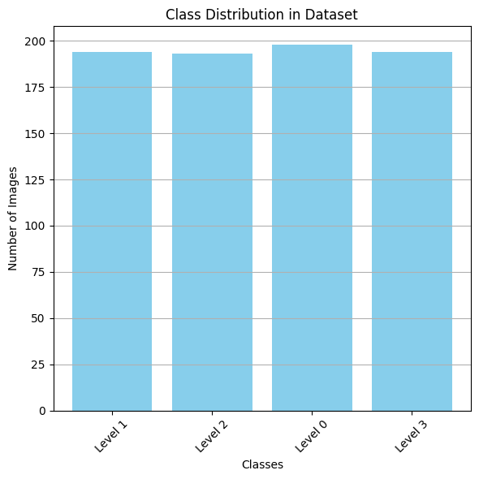
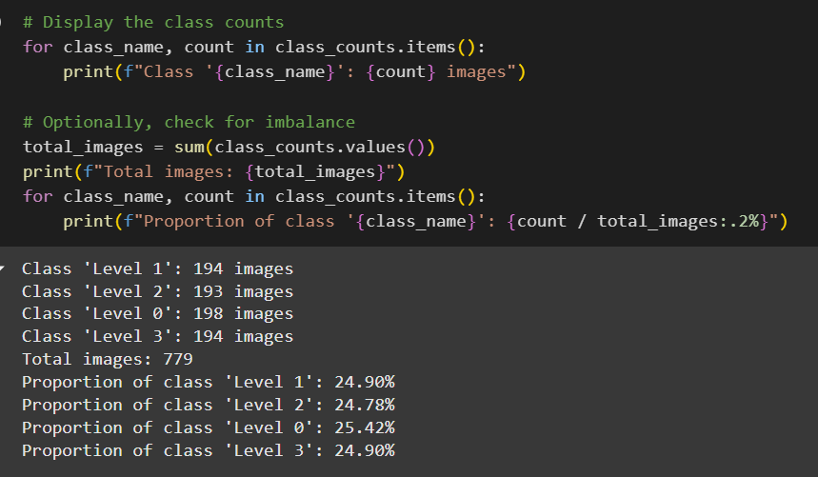
Exploratory Data Analysis
Acne Severity Dataset
IT21176456 | Gimmana M.R.M | 24-25J-210

Slide 26
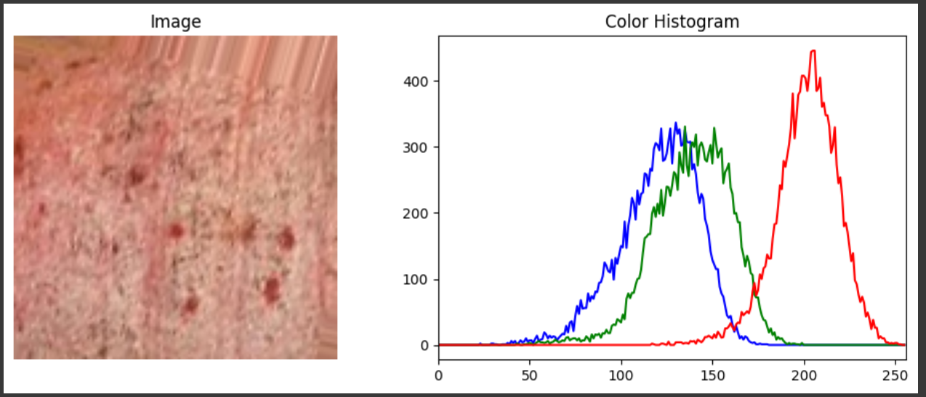
Exploratory Data Analysis
Color Histogram
Acne often presents with specific color characteristics, such as redness, inflammation, or variations in skin tone. By analyzing the color distribution of images in our dataset, we can gain insights into these characteristics and how they might differentiate acne from non-acne images.
IT21176456 | Gimmana M.R.M | 24-25J-210

Slide 27
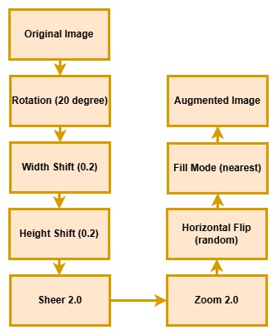
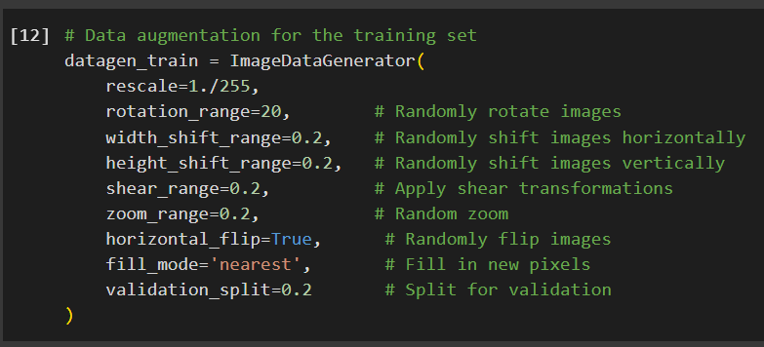
Data Augmentation
Data Augmentation using ImageDataGenerator
IT21176456 | Gimmana M.R.M | 24-25J-210

Slide 28
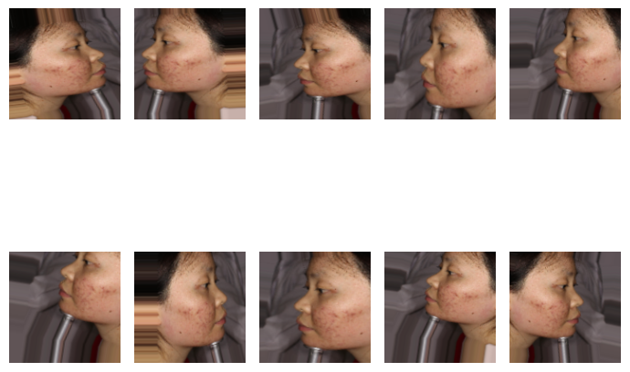
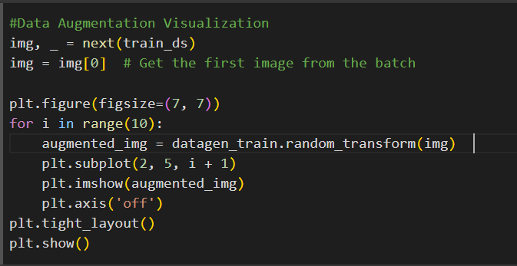
Data Augmentation
Data Augmentation Visualization
IT21176456 | Gimmana M.R.M | 24-25J-210

Slide 29
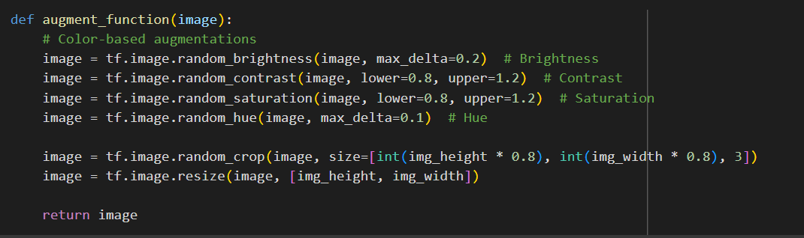
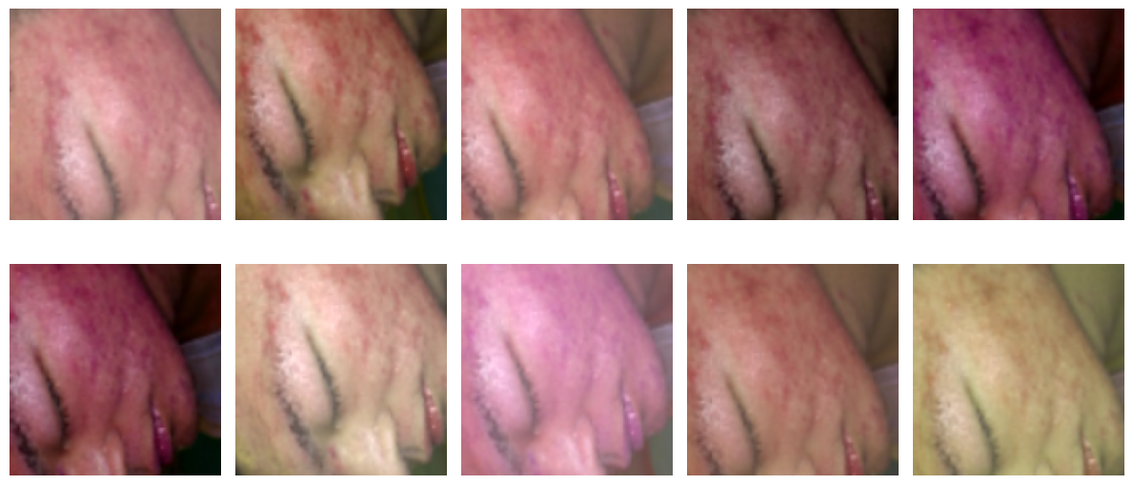
Data Augmentation
Color Based Augmentation Visualization
IT21176456 | Gimmana M.R.M | 24-25J-210

Slide 30
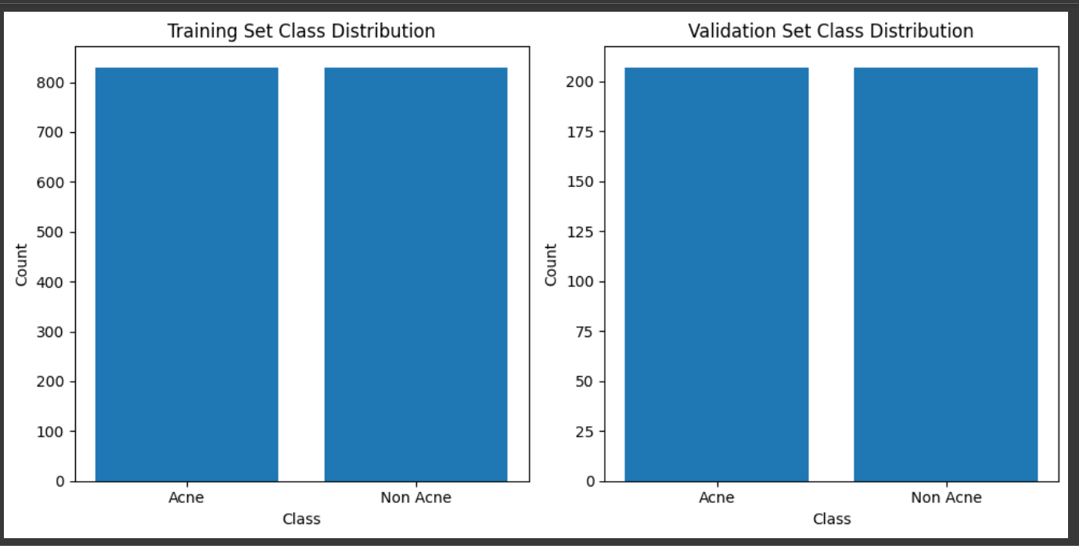
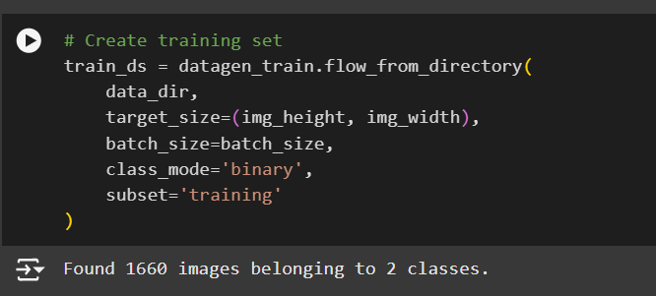
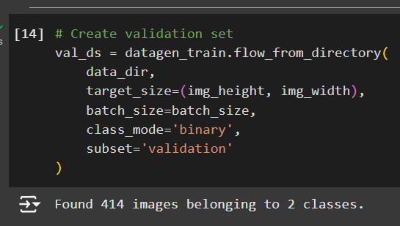
Data Preprocessing
Splitting Dataset Into Training and Validation
IT21176456 | Gimmana M.R.M | 24-25J-210

Slide 31
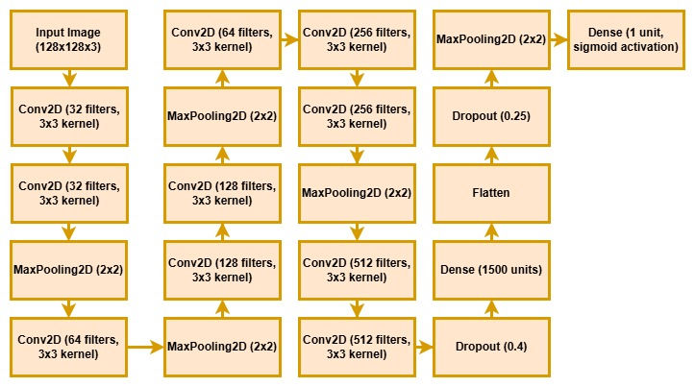
Training Deep Learning Models
CNN Model
IT21176456 | Gimmana M.R.M | 24-25J-210

Slide 32
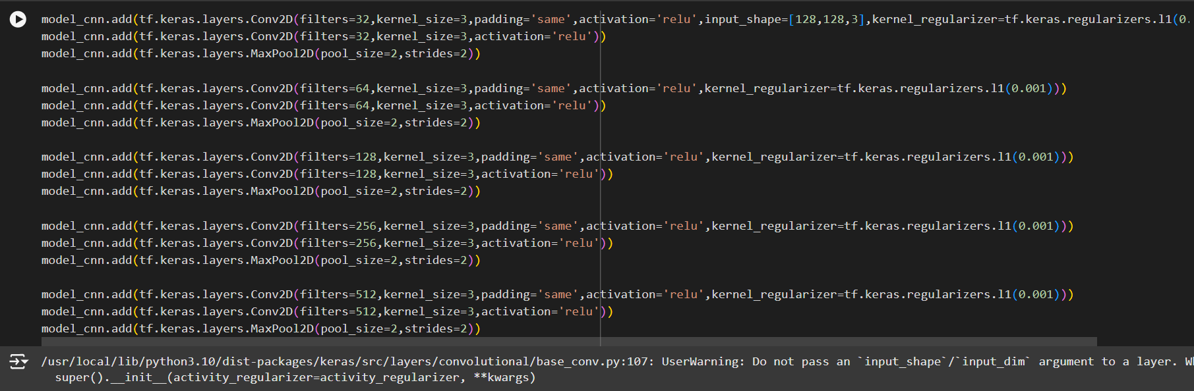
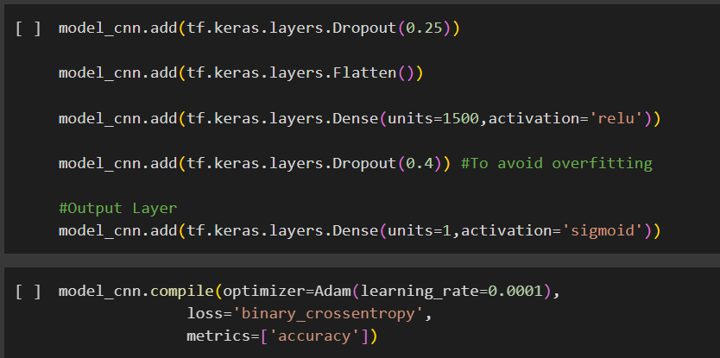
IT21176456 | Gimmana M.R.M | 24-25J-210

Slide 33
Training Deep Learning Models
Why CNN Model
Automatic Feature Extraction
CNNs excel at automatically learning relevant features from images, eliminating the need for manual feature engineering. This is crucial for acne detection, as the visual characteristics of acne lesions can be complex and varied.
Spatial Awareness
CNNs preserve the spatial relationships between pixels, which is important for understanding the distribution and arrangement of acne lesions within an image.
IT21176456 | Gimmana M.R.M | 24-25J-210

Slide 34
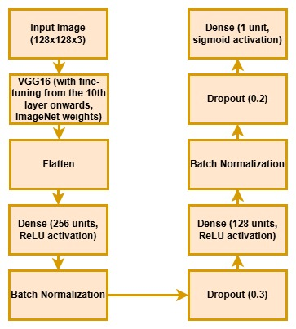
Training Deep Learning Models
VGG 16 Model
IT21176456 | Gimmana M.R.M | 24-25J-210

Slide 35
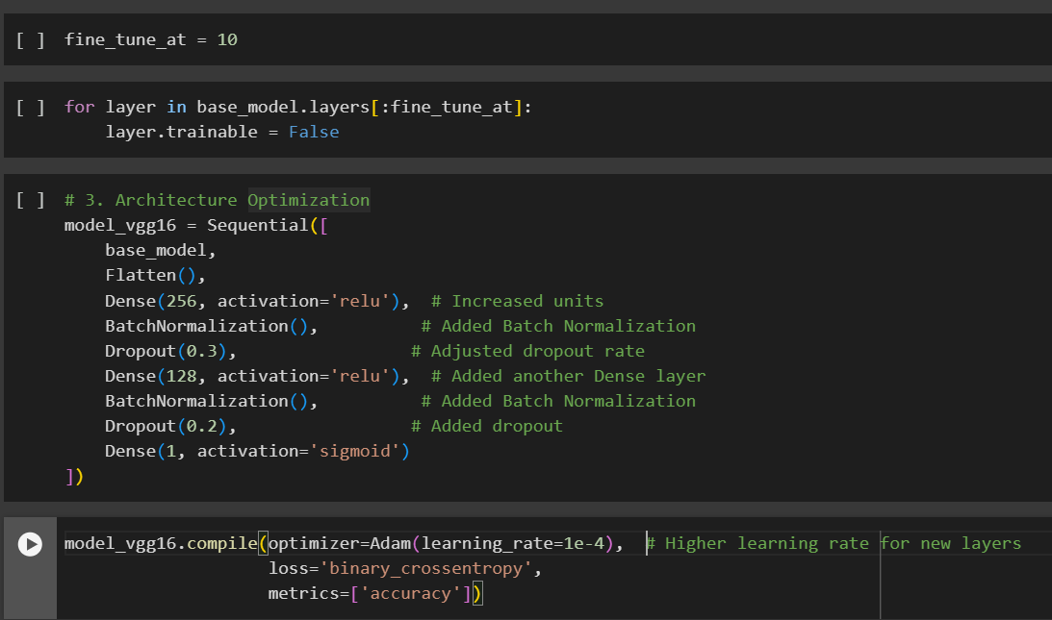
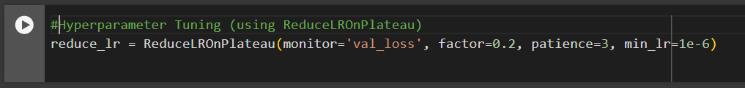
IT21176456 | Gimmana M.R.M | 24-25J-210

Slide 36
Training Deep Learning Models
Why VGG16 Model
Strong Feature Extractor
VGG16's deep architecture with small convolutional filters (3x3) allows it to learn a rich hierarchy of features, which is important for capturing the details and variations in acne lesions.
Transfer Learning
Can use pre-trained VGG16 weights from ImageNet and fine-tune them on our acne dataset.
IT21176456 | Gimmana M.R.M | 24-25J-210

Slide 37
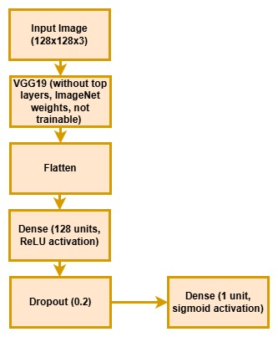
Training Deep Learning Models
VGG 19 Model
IT21176456 | Gimmana M.R.M | 24-25J-210

Slide 38
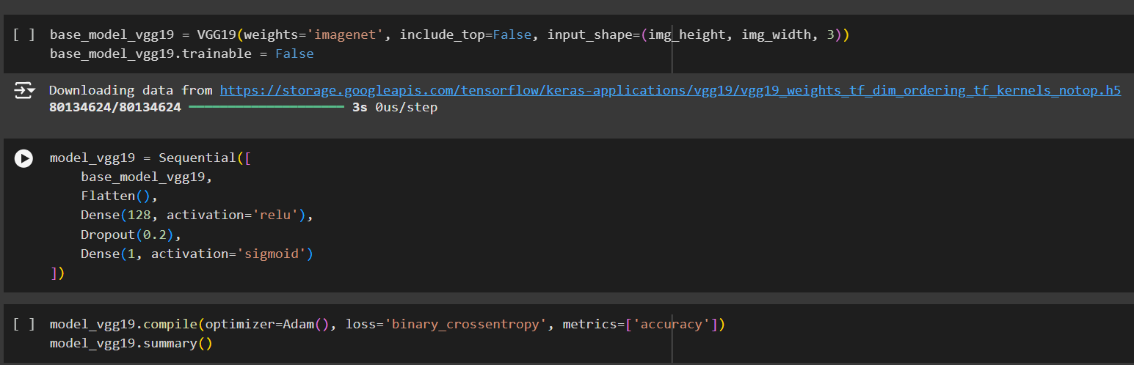
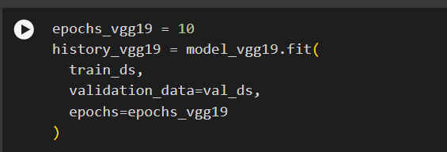
IT21176456 | Gimmana M.R.M | 24-25J-210

Slide 39
Training Deep Learning Models
Why VGG19 Model
Deep Architecture
VGG19's depth allows it to learn hierarchical features, capturing intricate details and patterns relevant to acne lesions.
Transfer Learning
Can use pre-trained VGG19 weights from ImageNet and fine-tune them on our acne dataset.
IT21176456 | Gimmana M.R.M | 24-25J-210

Slide 40
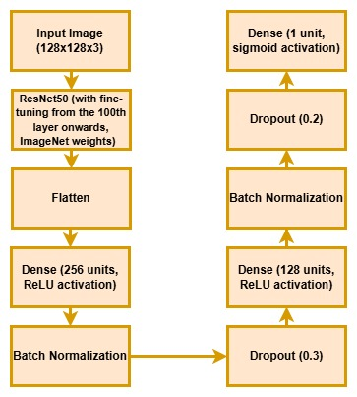
Training Deep Learning Models
ResNet50 Model
IT21176456 | Gimmana M.R.M | 24-25J-210

Slide 41
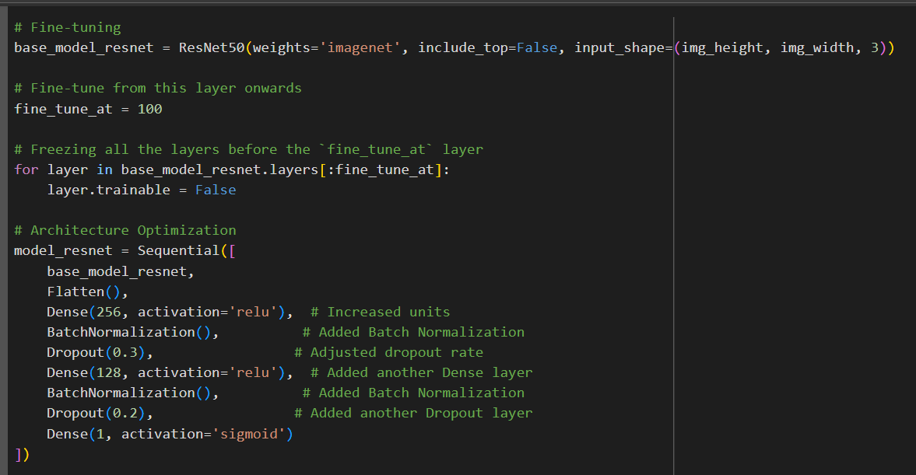
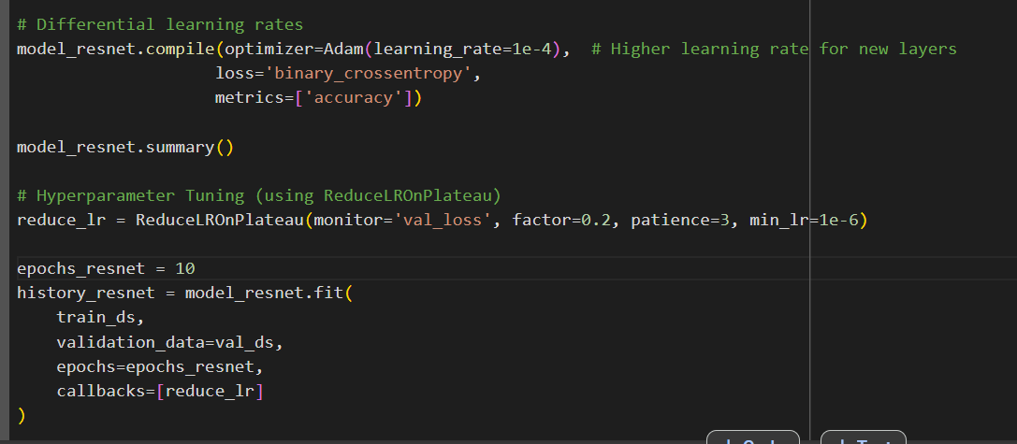
IT21176456 | Gimmana M.R.M | 24-25J-210

Slide 42
Training Deep Learning Models
Why ResNet Model
Improved Gradient Flow
The residual connections help with better gradient flow during training, leading to faster convergence and potentially better performance.
Popularity
ResNet has demonstrated excellent performance in various image recognition tasks, including medical image analysis.
IT21176456 | Gimmana M.R.M | 24-25J-210

Slide 43
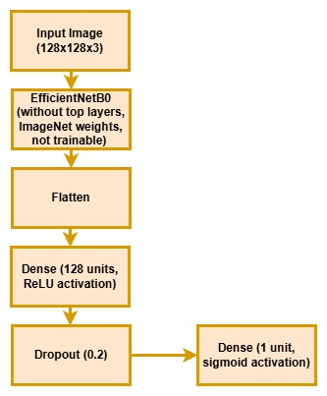
Training Deep Learning Models
EfficientNetB0 Model
IT21176456 | Gimmana M.R.M | 24-25J-210

Slide 44
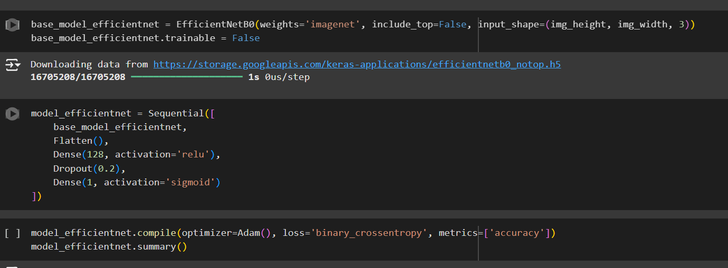
IT21176456 | Gimmana M.R.M | 24-25J-210

Slide 45
Training Deep Learning Models
Why EfficientNet Model
Scalability
EfficientNet is a family of models designed to scale efficiently. We can choose different versions (B0, B1, ..., B7) with varying levels of complexity and accuracy. This allows us to balance performance and computational resources.
Compound Scaling
EfficientNet uses a compound scaling method that balances network depth, width, and resolution to optimize performance. This can lead to improved accuracy with fewer parameters.
IT21176456 | Gimmana M.R.M | 24-25J-210

Slide 46
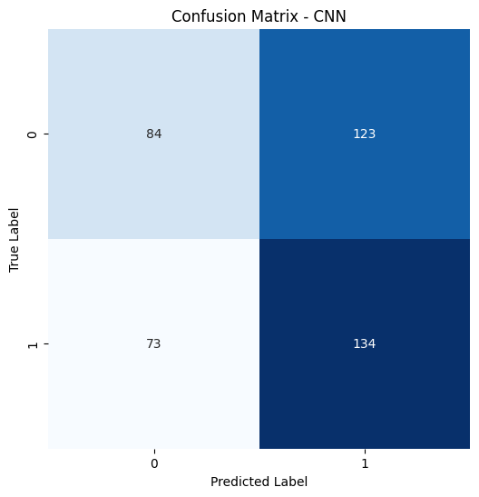
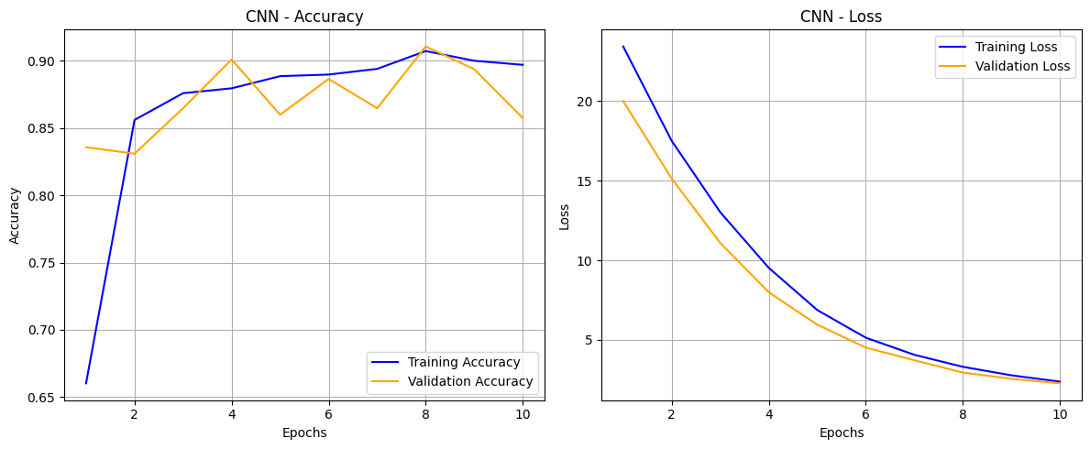
Model Evaluation
CNN
IT21176456 | Gimmana M.R.M | 24-25J-210

Slide 47
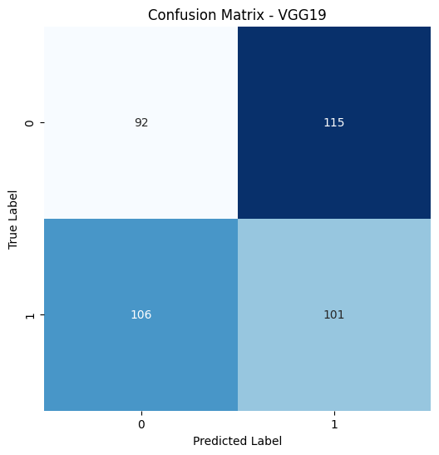
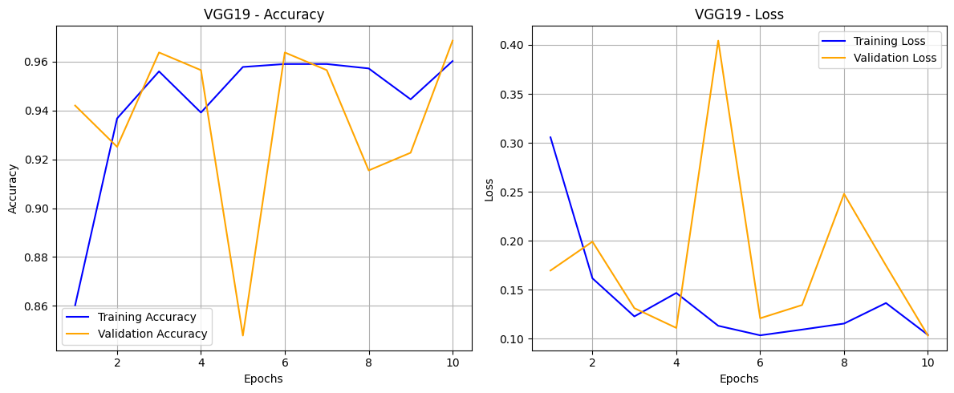
Model Evaluation
VGG19
IT21176456 | Gimmana M.R.M | 24-25J-210

Slide 48


Model Evaluation
VGG16
IT21176456 | Gimmana M.R.M | 24-25J-210

Slide 49


Model Evaluation
ResNet50
IT21176456 | Gimmana M.R.M | 24-25J-210

Slide 50


Model Evaluation
EfficientNetB0
IT21176456 | Gimmana M.R.M | 24-25J-210

Slide 51

Model Evaluation
Accuracy Comparison of Models
IT21176456 | Gimmana M.R.M | 24-25J-210

Slide 52


Testing Best Model
Testing Best Model Validation Data
IT21176456 | Gimmana M.R.M | 24-25J-210

Slide 53


Backend Implementation
IT21176456 | Gimmana M.R.M | 24-25J-210

Slide 54


Backend Implementation
IT21176456 | Gimmana M.R.M | 24-25J-210

Slide 55



Backend Implementation
IT21176456 | Gimmana M.R.M | 24-25J-210

Slide 56


Backend Implementation
IT21176456 | Gimmana M.R.M | 24-25J-210

Slide 57
Future Works
Novelty
Explore the use of Siamese Neural Networks for acne severity detection
Localization
Implement Faster R-CNN (Region-based Convolutional Neural Network) for acne lesion localization. This would allow the model to not only classify images as acne/non-acne but also identify the specific location of acne lesions within the image
Future Work ~ 50%
Explainable AI (XAI)
Incorporate Explainable AI techniques (e.g., Grad-CAM, LIME) to provide insights into the model's decision-making process
Model Enhancement
Continue to explore and implement techniques to enhance the performance of the deep learning
UI/UX
Create a User-Friendly Web Application for Users
IT21176456 | Gimmana M.R.M | 24-25J-210

Slide 58
Reference
[1] Rohit Yadav , Aashika jain , Sanjiv Sharma . “Acne Detection Care System using Deep Learning”. 2024 11th International Conference on Reliability, Infocom Technologies and Optimization (Trends and Future Directions) (ICRITO) | 979-8-3503-5035-7/24/$31.00 ©2024 IEEE | DOI: 10.1109/ICRITO61523.2024.1052241
[2] Krithika Naidu , omkar Kareppa , Sridha Menon , Chitra Bhole , Dr.Shital Poojary . “Dermato: A Deep Learning based Application for Acne Subtype and Severity Detection”. International Conference on Innovative Data Communication Technologies and Application (ICIDCA-2023) IEEE Xplore Part Number: CFP23CR5-ART; ISBN: 979-8-3503-9720-8
[3] Jawad Humayun , Aamir Saeed Malik , Samir Brahim Belhaouari , Nidal Kamel . “Localization of Acne Lesion through Template Matching”. Electrical and Electronic Engineering Department University Technology PETRONAS. 2012 4th International Conference on Intelligent and Advanced Systems (ICIAS2012).
[4] Kusum Meda Ravi , Krian M K , Umadevi V . “Acne Classification using Deep Learning Models “ . 2024 1st International Conference on Communications and Computer Science (InCCCS) | 979-8-3503-5885-8/24/$31.00 ©2024 IEEE | DOI: 10.1109/INCCCS60947.2024.10593603
[5] Paluri Krishna Veni , Ashish Gepta . “Revolutionizing Acne Diagnosis with Hybrid Deep Learning Model integrating CBAM and Capsule Network “. Received 4 May 2024, accepted 6 June 2024, date of publication 11 June 2024, date of current version 19 June 2024.
IT21176456 | Gimmana M.R.M | 24-25J-210

Slide 59

Component 2
Utilizing Advanced Machine Learning Technologies For Detailed Eczema Diagnosis And Assessment
IT21262104 | Lakshani D.M.W.S
B.Sc (Hons) Degree in Information Technology Specializing in Data Science
IT21262104 | Lakshani D.M.W.S | 24-25J-210

Slide 60
Background
What is Eczema?
What are the current challenges and need for an advanced solution?
How Advanced Machine Learning Techniques Can Improve the Assessment of Eczema Lesions?
IT21262104 | Lakshani D.M.W.S | 24-25J-210

Slide 61



What is Eczema?
A common skin condition.
Skin becomes dry, itchy and easily irritated.
Affects individuals of all ages and can significantly impact quality of life.
Possible to spread to different areas of the body.
Eczema can be caused by,
Dry climate
Foods
Cosmetics
Soaps
Wool
Dust mites
Mold
Pets
Pollen
IT21262104 | Lakshani D.M.W.S | 24-25J-210

Slide 62





Multiple Types of Eczema
Atopic Dermatitis
Often begins in childhood.
A common type of Eczema.
Nummular Eczema
Appears as coin-shaped spots on the skin that can be painful and difficult to treat.
Contact Dermatitis
Called allergic contact dermatitis. Causes an allergic skin reaction.
Seborrheic Dermatitis
Usually affects the scalp.
Rarely causes severe harm to the body.
Dyshidrotic Eczema
Tiny blisters on your hands, feet, or both.
IT21262104 | Lakshani D.M.W.S | 24-25J-210

Slide 63
Current Challenges
Diagnosis
Relies heavily on visual inspection by dermatologists, which can be subjective and inconsistent.
Early Detection
Failure to detect early signs can lead to progression and complications, increasing patient discomfort and healthcare costs.
IT21262104 | Lakshani D.M.W.S | 24-25J-210

Slide 64

Research Problem
How can advanced machine learning technologies be effectively utilized to improve the accuracy, efficiency, and consistency of eczema diagnosis and severity assessment from images?
IT21262104 | Lakshani D.M.W.S | 24-25J-210

Slide 65

System Diagram
IT21262104 | Lakshani D.M.W.S | 24-25J-210

Slide 66
Requirements
Personal Requirements
Guidance from the Supervisors on the Eczema and Data Science domain.
Understand the Specific Area of Each Domain to Proceed with the Selected Research Area.
Functional Requirements
Eczema Detection Module.
Severity Assessment Module.
Dynamic Segmentation Adjustment.
Adaptive Multi-Scale Attention Mechanism.
Non-Functional Requirements
Performance
Scalability
Usability
Security and Privacy
Reliability
IT21262104 | Lakshani D.M.W.S | 24-25J-210

Slide 67
Completed Tasks
Completed Work ~ 50%
Prepared the dataset for psoriasis detection and severity classification in collaboration with dermatologists to validate severity levels.
Conducted data preprocessing to standardize the dataset and applied data augmentation techniques to enhance training and testing samples.
Implemented models for eczema detection to identify affected.
Developed models for eczema severity classification for accurate severity level categorization.
Implemented attention mechanisms inside the model to enhance the accuracy.
Created a web application to test classification and detection results using the trained models.
IT21262104 | Lakshani D.M.W.S | 24-25J-210

Slide 68




Data Collection
Two Key Datasets:
Eczema Detection:
Categorization into "eczema" or "not eczema.“
Severity Classification:
Labels for mild, moderate, severe cases.
IT21262104 | Lakshani D.M.W.S | 24-25J-210

Slide 69


Data Validation
Data collections were reviewed and validated with external supervisors.
Input was provided based on clinical expertise and knowledge to ensure the quality and accuracy of labels.
Adjustments based on supervisor feedback.
Removal of ambiguous data to enhance dataset reliability.
IT21262104 | Lakshani D.M.W.S | 24-25J-210

Slide 70




Data Analysis
To understand the dataset.
To guide preprocessing decisions by informing strategies for scaling, encoding, and normalization.
To detect imbalances and bias.
IT21262104 | Lakshani D.M.W.S | 24-25J-210

Slide 71


Data Preprocessing
Image loading and labeling
Image resizing
Color conversion from default OpenCV BGR format to the standard RGB
Data normalization
Data augmentation
Train-validation split
IT21262104 | Lakshani D.M.W.S | 24-25J-210

Slide 72

Model Implementation for Eczema Detection
CNN
Used because they can automatically detect important patterns like edges, textures, and shapes.
Enhanced model incorporating attention mechanisms through Squeeze-and-Excitation (SE) blocks, and batch normalization.
Introduced kernel regularization, moderate dropout, and advanced training callbacks like early stopping, learning rate reduction, and model checkpointing.
Incorporated improved regularization with an L2 penalty, moderate dropout, and more sophisticated class balancing using dynamic class weights to address imbalance.
Optimized attention-based feature learning by refining the Squeeze-and-Excitation (SE) blocks, providing enhanced feature recalibration for more precise classification.
IT21262104 | Lakshani D.M.W.S | 24-25J-210

Slide 73

Model Implementation for Eczema Detection
Attention Mechanism
Help models focus on the most important parts of the data, improving decision-making by prioritizing relevant features over irrelevant ones.
Directs the model's attention to critical regions, such as affected skin areas, ensuring precise identification and classification of eczema.
Enhances feature extraction, reduces noise, and
improves classification accuracy by focusing on regions
that matter the most in an image.
IT21262104 | Lakshani D.M.W.S | 24-25J-210

Slide 74

Model Implementation for Eczema Detection
MobileNetV2
Used because of its lightweight architecture and efficiency, making it ideal for image processing tasks.
Introduced fine-tuning of MobileNetV2 layers, increased dropout, L2 regularization, batch normalization, learning rate scheduling, early stopping, and advanced data augmentation.
Introduced an attention mechanism with a squeeze-and-excite block, class weight handling to address data imbalance, and enhanced monitoring with early stopping, learning rate reduction, and model checkpointing.
Enhanced robustness with increased data augmentation parameters, L2 regularization for better weight control, a higher dropout rate to prevent overfitting, and fine-tuning from a deeper layer of the MobileNetV2 base.
Incorporated batch normalization for improved stability, a reduced fully connected layer size for efficiency, an increased dropout rate for enhanced regularization, and a lower learning rate for fine-tuning.
IT21262104 | Lakshani D.M.W.S | 24-25J-210

Slide 75



Model Implementation for Eczema Detection
ResNet50
Used because of its ability to handle deep architectures efficiently, extracting rich and detailed features for accurate image classification.
Leveraged ResNet50 as a feature extractor combined with a custom attention mechanism for enhanced focus on relevant features.
Optimized transfer learning with selective layer freezing in ResNet50, dynamic adjustment of training steps, and refined fine-tuning with a lower learning rate.
Incorporated enhanced data augmentation with brightness variations, increased dropout and regularization, class weight balancing to address dataset imbalances, and advanced training with early stopping and dynamic learning rate adjustment.
IT21262104 | Lakshani D.M.W.S | 24-25J-210

Slide 76
Model Implementation for Eczema Detection
CNN
Efficiency
Better regularization
Customizability
Improved accuracy
IT21262104 | Lakshani D.M.W.S | 24-25J-210

Slide 77


Model Implementation for Eczema Severity Assessment
EfficientNetB0
Used because of its optimized design, balancing high accuracy and computational efficiency combining high performance with low resource usage.
Utilized pre-trained EfficientNetB0 architecture with a simplified structure, global average pooling, and fully connected layers to classify eczema severity (mild, moderate, severe) with enhanced performance through class balancing, fine-tuning, and adaptive learning rate optimization.
Integrated advanced CBAM and SE attention mechanisms for enhanced feature refinement, employs a warm-up cosine decay learning rate scheduler for optimized training, and incorporates additional dense layers with L2 regularization.
Incorporated focal loss to address class imbalance, batch normalization for improved training stability, and a cosine decay learning rate scheduler for efficient optimization.
IT21262104 | Lakshani D.M.W.S | 24-25J-210

Slide 78

Model Implementation for Eczema Severity Assessment
CNN
Used because they can automatically detect important patterns like edges, textures, and shapes.
Designed to classify eczema into three categories using a combination of convolutional layers for advanced feature extraction and pooling layers for dimensionality reduction.
Incorporated techniques such as class balancing through weighted loss, dropout layers to prevent overfitting, and batch normalization to stabilize training and improve generalization.
Trained with early stopping and model checkpointing, the model achieves high accuracy, demonstrating its robustness in handling image-based skin condition classification tasks.
IT21262104 | Lakshani D.M.W.S | 24-25J-210

Slide 79

Model Implementation for Eczema Severity Assessment
ResNet50
Used because of its ability to handle deep architectures efficiently, extracting rich and detailed features for accurate image classification.
Enhanced the model by fine-tuning the ResNet50 backbone, adding L2 regularization, using AdamW optimizer with weight decay, implementing advanced callbacks for dynamic learning rate adjustment, and increasing the dense layer capacity.
Integrated SMOTE for oversampling imbalanced classes, adding a cosine learning rate scheduler, introducing an additional dense layer for feature representation, reducing dropout rates for better generalization, and incorporating a custom F1-score callback to monitor performance beyond accuracy.
Integrated a Convolutional Block Attention Module (CBAM) for improved feature refinement, employs DropBlock regularization for spatial dropout in feature maps, and uses a custom learning rate schedule for better optimization, further advancing its ability to classify eczema severity.
IT21262104 | Lakshani D.M.W.S | 24-25J-210

Slide 80
Model Implementation for Eczema Severity Assessment
EfficientNetB0
Flexibility with Fine-Tuning
Lightweight and Resource Efficient
Optimized Pre-trained Architecture
Improved accuracy
Performance Metrics
IT21262104 | Lakshani D.M.W.S | 24-25J-210

Slide 81



Web Application Development
IT21262104 | Lakshani D.M.W.S | 24-25J-210

Slide 82
Future Works
Model enhancement
Incorporating XAI
Integrated web application completion
Documentation
Eczema progress tracking functionality implementation
IT21262104 | Lakshani D.M.W.S | 24-25J-210

Slide 83
References
[1] Nisar, K., Zubair, M., & Rauf, H. T. (2020). "Automatic Segmentation and Classification of Eczema Skin Lesions Using Supervised Learning," 2020 IEEE Conference on Open Systems (ICOS), pp. 53-58. DOI: 10.1109/ICOS48179.2021.9398739.
[2] I. B. I. Raja, S. H. Abid, A. B. M. H. Rashid, & A. R. Arif. (2019). "Detection of Common Types of Eczema Using Gray Level Co-occurrence Matrix and Support Vector Machine," 2019 International Conference on Advanced Computing and Communication Systems (ICACCS), pp. 1-5. DOI: 10.1109/ICACCS.2019.8728514.
[3] M. Y. Cheong, & Y. A. Hamed. (2020). "Reliable Detection of Eczema Areas for Fully Automated Assessment of Eczema Severity from Digital Camera Images," 2020 IEEE EMBS Conference on Biomedical Engineering and Sciences (IECBES), pp. 362-366. DOI: 10.1109/IECBES48179.2021.9398739.
[4] Zhang, Y., Li, H., Wang, X., & Yang, J. (2021). "EczemaNet: A Deep CNN-based Eczema Diseases Classification," 2021 IEEE 15th International Conference on Anti-counterfeiting, Security, and Identification (ASID), pp. 45-49. DOI: 10.1109/ASID53146.2021.9618825.
[5] R. T. Tong, S. H. Lee, & P. H. Lee. (2020). "Segmentation of Eczema Skin Lesions Using U-Net," 2020 IEEE EMBS Conference on Biomedical Engineering and Sciences (IECBES), pp. 359-361. DOI: 10.1109/IECBES48179.2021.9398739.
IT21262104 | Lakshani D.M.W.S | 24-25J-210

Slide 84

Component 3
Automated AI-augmented Approach To Psoriasis Lesion Detection And Accurate Severity Evaluation
IT21261732 | Perera W.A.S.K
B.Sc (Hons) Degree in Information Technology Specializing in Data Science
IT21261732 | Perera W.A.S.K | 24-25J-210

Slide 85
Background
What is psoriasis and what is scaling?
Why is accurate detection and segmentation of psoriasis lesions important?
How can advanced machine learning techniques improve the precision and reliability of psoriasis assessment?
IT21261732 | Perera W.A.S.K | 24-25J-210

Slide 86

What is psoriasis and what is scaling?
Nature of Psoriasis
What is Scaling
Buildup of excess skin
cells
Chronic skin disease
Appears as thick,
silvery patches on the
skin
Rapid growth of skin
cells
Leads to the buildup of scales and inflammation
Indicates the severity
IT21261732 | Perera W.A.S.K | 24-25J-210

Slide 87

---
Why is accurate detection and segmentation of psoriasis lesions important?
Ensures Timely Treatment
Improves Patient Outcomes
Reduces the psychological and
physical burden on patients
IT21261732 | Perera W.A.S.K | 24-25J-210

Slide 88

---
---
How can advanced machine learning techniques improve the precision and reliability of psoriasis assessment?
Enhanced Precision
Consistent and unbiased analysis
Enables real-time assessment
and monitoring
IT21261732 | Perera W.A.S.K | 24-25J-210
IT21261732 | Perera W.A.S.K | 24-25J-210

Slide 89

Automated Ai-augmented Approach To Psoriasis Lesion Detection And Accurate Scaling Severity Evaluation
Research Problem
In what ways can cutting-edge machine learning methodologies be leveraged to significantly improve the precision, efficiency, and reliability of psoriasis detection, segmentation, feature extraction, and scaling severity assessment from digital images?
IT21261732 | Perera W.A.S.K | 24-25J-210

Slide 90
Requirements
Personal Requirements
Guidance from the Supervisors on the Psoriasis and Data Science domain.
Gain a deep understanding of the specific areas within the Psoriasis and data science fields to proceed with the research effectively.
Functional Requirements
Psoriasis Detection and Segmentation Module
Feature Extraction Module
Psoriasis Scaling Severity Classification Module
Enhanced Scaling Severity Measurement Module
Non-Functional Requirements
Performance
Scalability
Usability
Security and Privacy
Reliability
IT21261732 | Perera W.A.S.K | 24-25J-210

Slide 91
Completed Tasks
Prepared the dataset for psoriasis detection and severity classification in collaboration with dermatologists to validate severity levels.
Conducted data preprocessing to standardize the dataset and applied data augmentation techniques to enhance training and testing samples.
Implemented models for psoriasis detection to identify affected areas with high precision.
Developed models for psoriasis severity classification for accurate severity level categorization.
Created a web application to test classification and detection results using the trained models.
Developed and tested a Python solution for scale segmentation, distribution analysis, and dispersion metrics using multi-scale superpixel segmentation. (novelty)
IT21261732 | Perera W.A.S.K | 24-25J-210

Slide 92

System Diagram
IT21261732 | Perera W.A.S.K | 24-25J-210

Slide 93


Data Preparing and Data Validation – About Data set
The initial dataset included 1752 psoriasis skin images and 1054 normal skin images.
Validation was performed to remove the majority of images based on clinical severity classification.
The new dataset for detection contains 270 psoriasis skin images and 270 normal skin images.
The new dataset for severity classification includes 100 images for Level 1 (Mild)
100 images for Level 2 (Moderate)
100 images for Level 3 (Severe).
IT21261732 | Perera W.A.S.K | 24-25J-210

Slide 94

Data Validation
Images validated to severity levels by external supervisors with clinical expertise.
Adjustments made to the dataset based on feedback from external supervisors.
Non-essential images removed as per external supervisor recommendations.
IT21261732 | Perera W.A.S.K | 24-25J-210

Slide 95


Data Analysis
Visualizing the distribution Across Classes
IT21261732 | Perera W.A.S.K | 24-25J-210

Slide 96


Data Analysis
Visualizing the distribution Across Classes
IT21261732 | Perera W.A.S.K | 24-25J-210

Slide 97



Data Preprocessing and Data Augmentation
Data preprocessing including
Image resizing
Convert to RGB
Normalizing Data
IT21261732 | Perera W.A.S.K | 24-25J-210

Slide 98



Data Preprocessing and Data Augmentation
Data Augmentation
IT21261732 | Perera W.A.S.K | 24-25J-210

Slide 99



Training Deep Learning Models - Detection
Efficientnetv2-B0
IT21261732 | Perera W.A.S.K | 24-25J-210

Slide 100


Training Deep Learning Models - Detection
Efficientnetv2-B0
Optimized for high accuracy with low computational cost, ideal for efficient detection.
Built the model using EfficientNetV2B0 as the base, fine-tuning all layers to enable better feature extraction for classification.
Integrated L2 kernel regularization and dropout layers to reduce overfitting and improve the model's robustness.
Added dense layers with ReLU activation and a softmax output layer for precise binary classification.
Trained the model with Adam optimizer and sparse categorical cross-entropy loss, validating it using augmented data for enhanced performance.
IT21261732 | Perera W.A.S.K | 24-25J-210

Slide 101


Training Deep Learning Models - Detection
Efficientnetv2-B0
IT21261732 | Perera W.A.S.K | 24-25J-210

Slide 102



Training Deep Learning Models - Detection
ResNet50
IT21261732 | Perera W.A.S.K | 24-25J-210

Slide 103


Training Deep Learning Models - Detection
ResNet50
Excellent at extracting features using deep residual learning.
Built the model using ResNet50 as the base, adding custom layers for better feature extraction and classification.
Integrated a dense layer with ReLU activation and a softmax output layer for binary classification of normal and psoriasis skin.
Used dropout regularization to reduce overfitting and improve model robustness.
Trained the model with the Adam optimizer and sparse categorical cross-entropy loss, validating it on a separate dataset for performance evaluation.
IT21261732 | Perera W.A.S.K | 24-25J-210

Slide 104



Training Deep Learning Models - Detection
CNN
IT21261732 | Perera W.A.S.K | 24-25J-210

Slide 105


Training Deep Learning Models - Detection
CNN
Custom-built for specific datasets to capture unique features.
Built a CNN model with three convolutional layers, each followed by max-pooling and dropout to extract hierarchical features while reducing overfitting.
Added dense layers with ReLU activation and a softmax output layer for binary classification of normal and psoriasis skin.
Compiled the model with the Adam optimizer and sparse categorical cross-entropy loss for effective training.
Trained the model for 30 epochs using augmented data, validating performance on a separate dataset to ensure robust classification.
IT21261732 | Perera W.A.S.K | 24-25J-210

Slide 106


Training Deep Learning Models - Detection
YOLO
IT21261732 | Perera W.A.S.K | 24-25J-210

Slide 107


Training Deep Learning Models - Detection
YOLO
Fast and accurate for real-time object detection and localization.
Defined the dataset YAML file with paths for training and validation data, along with class labels (normal skin / psoriasis skin).
Utilized the pre-trained YOLOv8 model for psoriasis detection, fine-tuning it on the custom dataset.
Visualized paired result images (ground truth vs. predictions) using a custom function for better interpretability of model outputs.
Evaluated model predictions on the validation set by generating classification reports, confusion matrices, and visual metrics to assess performance.
Validated the model using YOLOv8's built-in evaluation function to further analyze accuracy and performance.
IT21261732 | Perera W.A.S.K | 24-25J-210

Slide 108

Training Deep Learning Models - Detection
YOLO
IT21261732 | Perera W.A.S.K | 24-25J-210

Slide 109



Training Deep Learning Models - Detection
InceptionResNetV2
IT21261732 | Perera W.A.S.K | 24-25J-210

Slide 110


Training Deep Learning Models - Detection
InceptionResNetV2
Combines multi-scale feature detection with residual learning for better performance.
Built the model using InceptionResNetV2 as the base, adding global average pooling, dropout layers, and dense layers for binary classification(normal/ psoriasis skin).
Compiled the model with the Adam optimizer and sparse categorical cross-entropy loss for effective training.
Trained the model for 20 epochs using augmented data, validating performance on a separate dataset to ensure robust classification.
IT21261732 | Perera W.A.S.K | 24-25J-210

Slide 111

Training Deep Learning Models - Detection
InceptionResNetV2
IT21261732 | Perera W.A.S.K | 24-25J-210

Slide 112



Training Deep Learning Models – Severity Classification
MobileNetV2
IT21261732 | Perera W.A.S.K | 24-25J-210

Slide 113


Deep Learning Models – Severity Classification
MobileNetV2
Efficient and fast, ideal for severity classification on resource-constrained systems.
Built the model using MobileNetV2 as the base for transfer learning, freezing its layers to retain pre-trained weights for feature extraction.
Added custom layers, including global average pooling, dropout for regularization, and dense layers with softmax activation for multi-class classification.
Compiled the model with the Adam optimizer and categorical cross-entropy loss for effective training across multiple classes.
Trained the model for 30 epochs, using validation data to monitor performance and ensure robust classification.
IT21261732 | Perera W.A.S.K | 24-25J-210

Slide 114


Training Deep Learning Models – Severity Classification
CNN
IT21261732 | Perera W.A.S.K | 24-25J-210

Slide 115


Deep Learning Models – Severity Classification
CNN
Extracts detailed features from images, ensuring accurate severity classification.
Applied data augmentation techniques, including rotation, shifting, zooming, and horizontal flipping, to enhance data diversity.
Built a CNN model with convolutional layers, max-pooling, ReLU activation, dropout for regularization, and a softmax output layer for multi-class classification.
Compiled the model with the Adam optimizer and sparse categorical cross-entropy loss for effective multi-class classification.
IT21261732 | Perera W.A.S.K | 24-25J-210

Slide 116


Testing - Detection
IT21261732 | Perera W.A.S.K | 24-25J-210

Slide 117


Testing – Severity calcification
IT21261732 | Perera W.A.S.K | 24-25J-210

Slide 118

Backend Implementation
IT21261732 | Perera W.A.S.K | 24-25J-210

Slide 119


Backend Implementation
IT21261732 | Perera W.A.S.K | 24-25J-210

Slide 120
Multi-Scale Superpixel Segmentation and Analysis Framework
Performed Multi-Scale SLIC Segmentation at scales (100, 300, 500) to capture varying levels of detail.
Extracted properties such as area and centroid for each superpixel to analyze superpixel characteristics.
Computed mean pairwise distance and dispersion to measure superpixel clustering.
Extracted centroids and areas as feature vectors and standardized feature lengths for similarity calculation.
Calculated cosine similarity between images based on extracted superpixel features.
Highlighted superpixel boundaries and centroids on segmented images for visual comparison.
Compared image structure at different scales using similarity scores and dispersion analysis.
How Does This Help Doctors and Researchers in Psoriasis Analysis?
Provides accurate lesion segmentation and quantitative analysis, enabling objective evaluation and progress tracking.
Assists in identifying patterns and correlations between lesion characteristics and disease severity for better insights.
IT21261732 | Perera W.A.S.K | 24-25J-210

Slide 121




Multi-Scale Superpixel Segmentation and Analysis Framework
IT21261732 | Perera W.A.S.K | 24-25J-210

Slide 122


Multi-Scale Superpixel Segmentation and Analysis Framework
IT21261732 | Perera W.A.S.K | 24-25J-210

Slide 123


Multi-Scale Superpixel Segmentation and Analysis Framework
IT21261732 | Perera W.A.S.K | 24-25J-210

Slide 124
Future Works
Enhance detection and severity assessment models for improved accuracy.
Integrate Explainable AI (XAI) techniques to provide interpretable insights.
Develop and complete an integrated application for streamlined analysis and user accessibility.
Improve segmentation and similarity algorithms to boost performance in novelty.
IT21261732 | Perera W.A.S.K | 24-25J-210

Slide 125
References
References
[1] T. R. Arunkumar and H. S. Jayanna, "A Novel Approach For Automatic Identification Of Psoriasis Affected Skin Area," 2017 2nd International Conference On Emerging Computation and Information Technologies (ICECIT), Tumakuru, India, 2017, pp. 1-8, doi: 10.1109/ICECIT.2017.8453316.
[2] Y. George, M. Aldeen and R. Garnavi, "Automatic Scale Severity Assessment Method in Psoriasis Skin Images Using Local Descriptors," in IEEE Journal of Biomedical and Health Informatics, vol. 24, no. 2, pp. 577-585, Feb. 2020, doi: 10.1109/JBHI.2019.2910883
[3] L. Vincent and J. Roopa Jayasingh, "Comparison of Psoriasis Disease Detection and Classification Through Various Image Processing Techniques-A Review," 2022 6th International Conference on Devices, Circuits and Systems (ICDCS), Coimbatore, India, 2022, pp. 122-124, doi: 10.1109/ICDCS54290.2022.9780692.
[4] J. -M. Syu, C. -H. Lai, G. -S. Lin and S. -K. Chai, "Psoriasis Detection Based on Deep Neural Network," 2018 IEEE International Conference on Consumer Electronics-Taiwan (ICCE-TW), Taichung, Taiwan, 2018, pp. 1-2, doi: 10.1109/ICCE-China.2018.8448609.
[5] A. H. R. S. S. G. Manoharan, S. G. Senanayake, and A. G. A. J. S. Ja," International Conference on Advanced Communication Technology (ICACT), yarathna, "Evaluation of psoriasis skin disease classification using convolutional neural networkpp. 355-359, Feb. 2020.
IT21261732 | Perera W.A.S.K | 24-25J-210

Slide 126





Technologies Used
Development Environments
Jupyter Notebooks
Visual Studio Code
Database
Firebase
Web Frameworks
Flask
Django
Version Control and Collaboration Tools
GitHub
Deep Learning Frameworks
TensorFlow
Mask R-CNN
Machine Learning Libraries
scikit-learn
AutoKeras
Programming Languages
Python
Data Augmentation and Preprocessing Tools
OpenCV
Pandas
Matplotlib
Project ID: 24-25J-210

Slide 127
THANK YOU
Project ID: 24-25J-210

